Slide 1
CLOUD SOLUTIONS FOR TRANSIT

Slide 2
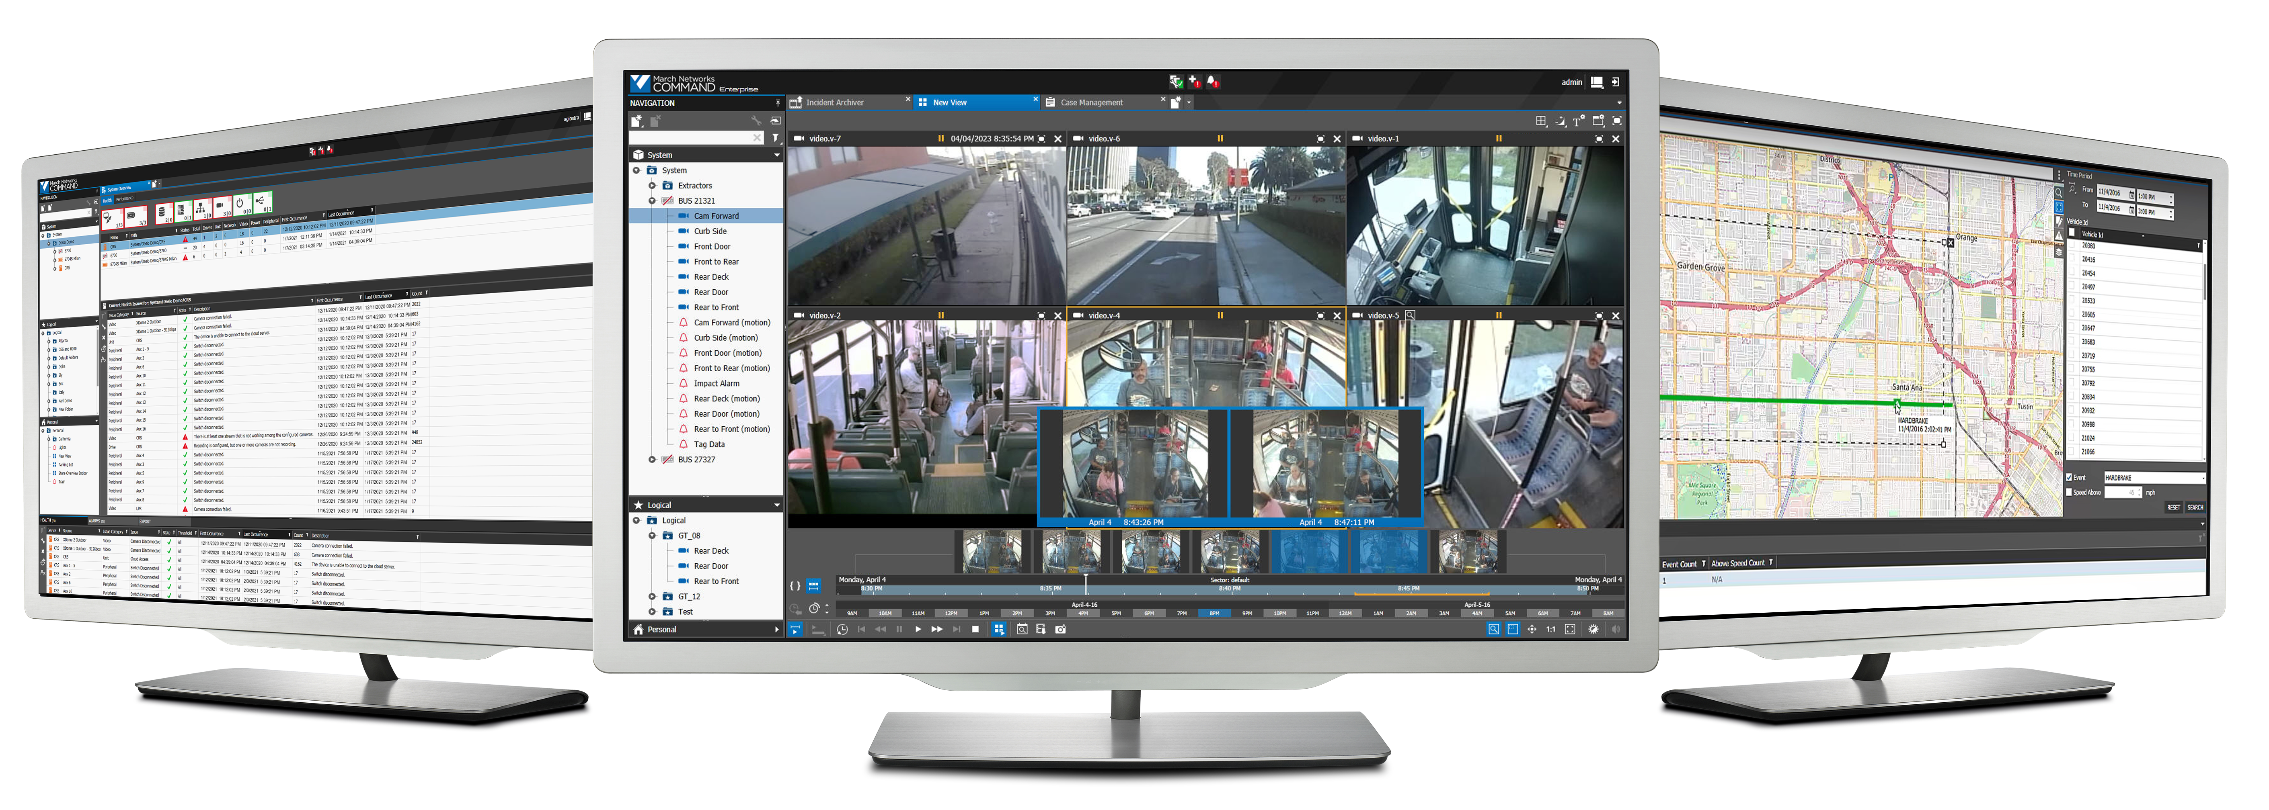
March Networks Overview
Leading the Transformation of Enterprise Video Surveillance to the Cloud
March Networks is a global leader in video surveillance and video-based business intelligence applications for the financial, retail and transit markets

Slide 3
Significant Presence and Industry Experience
#1
#1
More than 250,000
video surveillance systems sold
hardware NVR supplier in the Americas, and top 10 globally*
supplier of video surveillance equipment to banks in the Americas
* Source: IHS Markit, Video Surveillance Intelligence Service

Slide 4
Leading the Transformation of Enterprise Video Surveillance to the Cloud
Advantages of switching from on-premise to cloud video solution:
Offsite storage for enhanced redundancy to protect against loss of video
Enhanced cybersecurity and software updates allow transit agencies to focus on their core business
Simplified sharing of videos with essential stakeholders (law enforcement, etc.)
Save time and money with enhanced operational efficiencies
Reduction of IT costs

Slide 5
March Networks Cloud Suite for Transit

Slide 6
Cloud Management
Cloud Monitoring
Cloud Sharing
Cloud Suite
Cloud Storage
Cloud Analytics

Slide 7
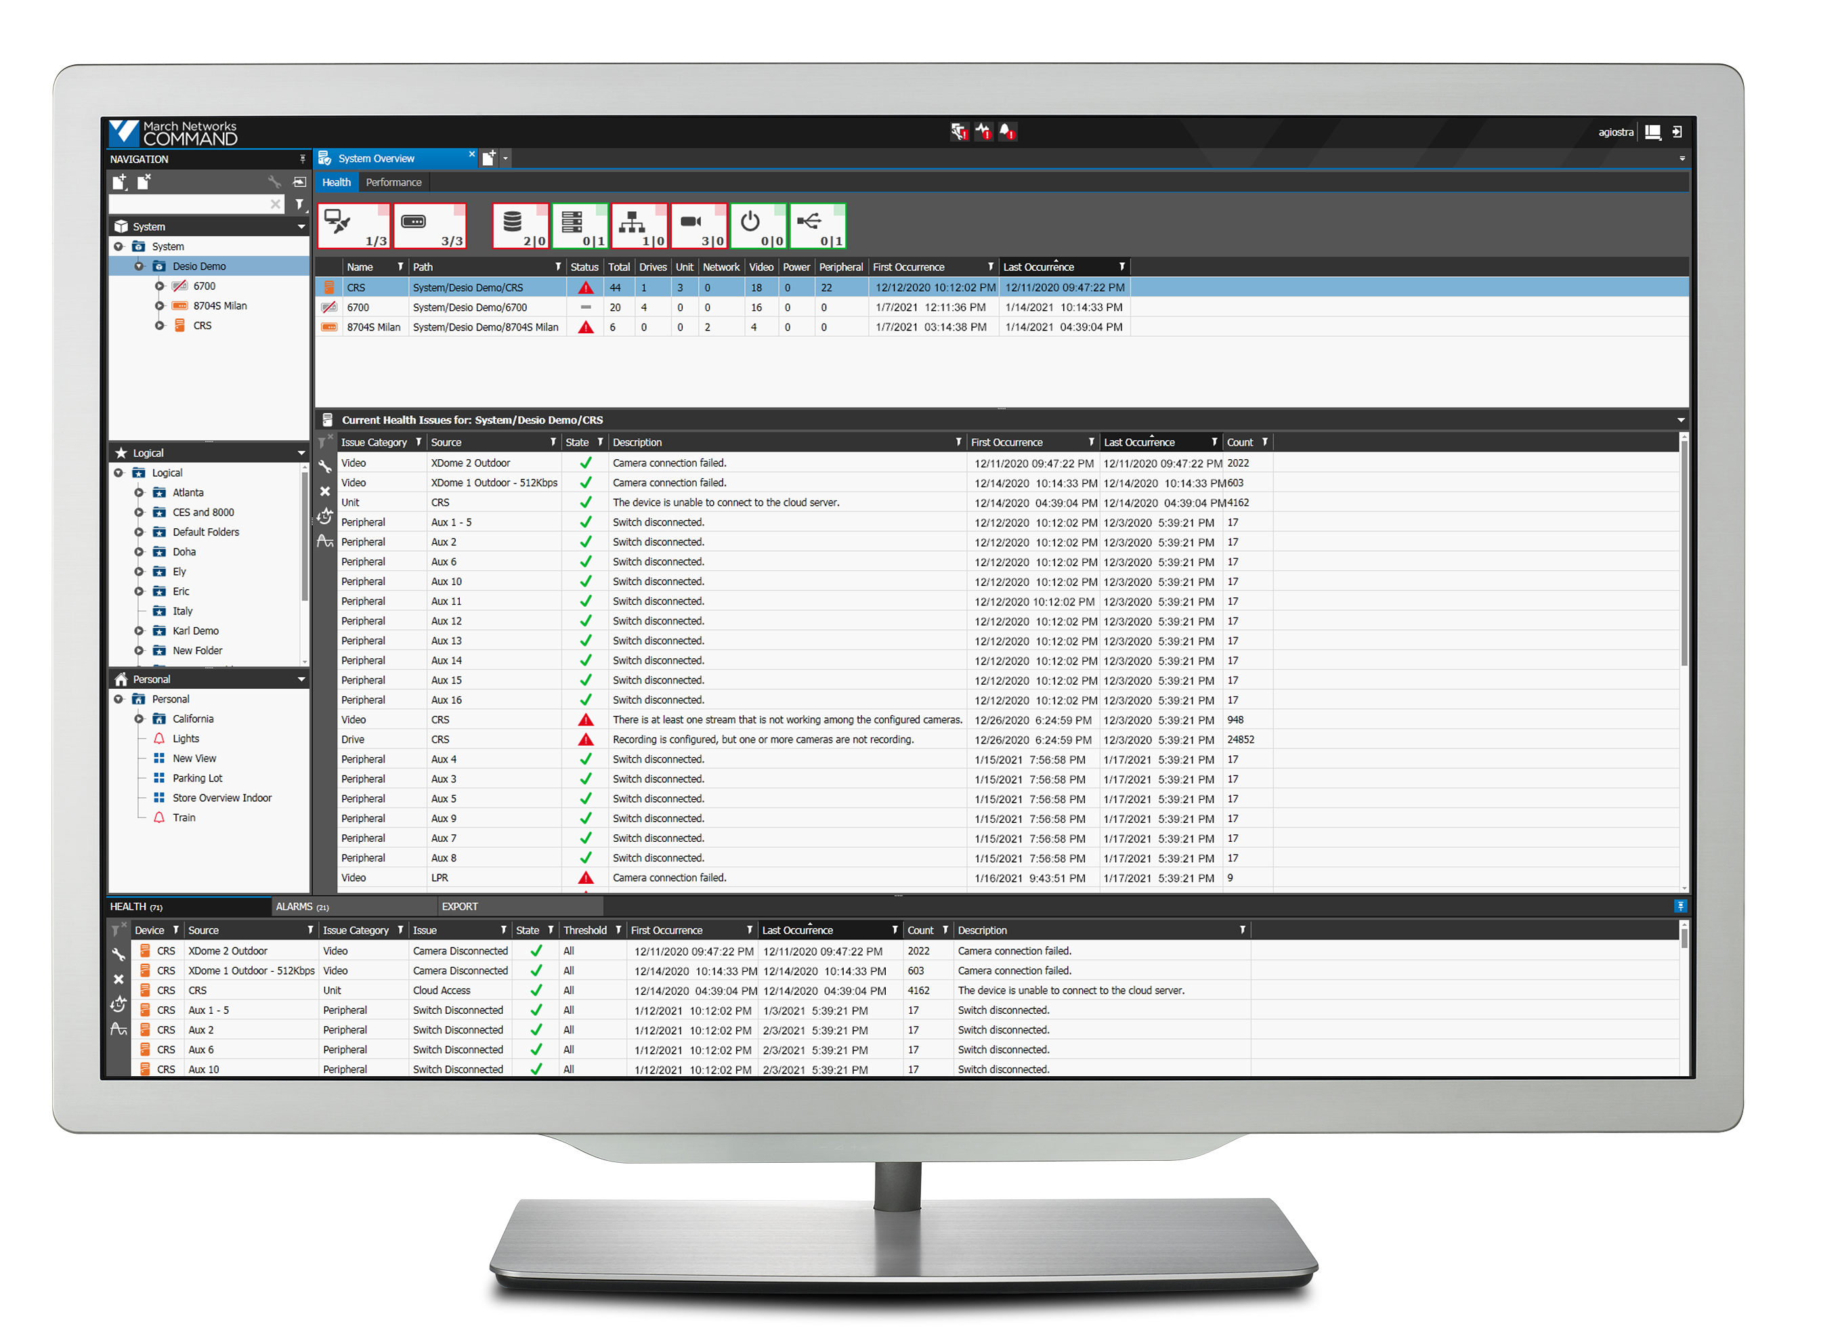
Cloud Management: Command Enterprise Software (CES) Cloud
Enterprise video surveillance management in the cloud
From small-scale to large-scale organizations, CES Cloud provides a centralized system and user management for ease of use
Support thousands of video recorders and video channels
Multi-level, user access privileges
Advanced, system-wide health monitoring
Mass firmware and configuration updates
Enterprise security with 2FA and SAML2.0 SSO
CES Media Archiver allows for flexible uploads and archiving of video evidence on a per-camera basis
Save time and money while March Networks handles:
Setting up and hosting your CES, adding users, and performing ongoing maintenance
Operation Audits configuration
No server software to update or install!

Slide 8
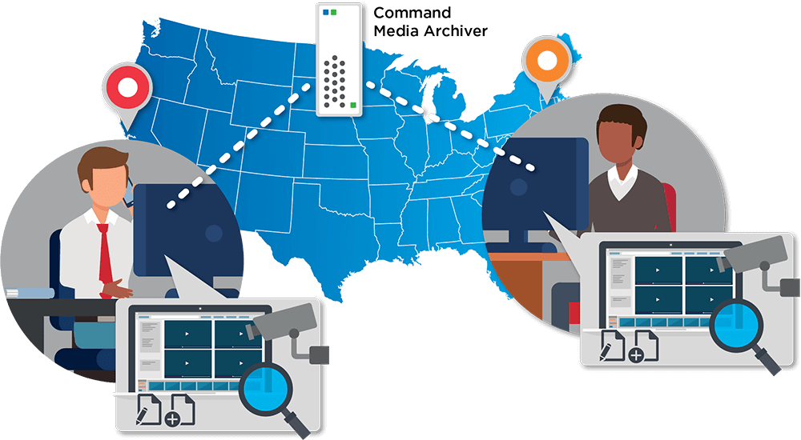
Cloud Management: CES Media Archiver
The CES Media Archiver Module allows for flexible uploads and archiving of video evidence on a per-camera basis, and multiple depot archives can be supported. The tool communicates upload status, and in the event that an upload does not reach completion, the system can accommodate an incomplete upload via incremental extractions that continue at key frame level.

Slide 9
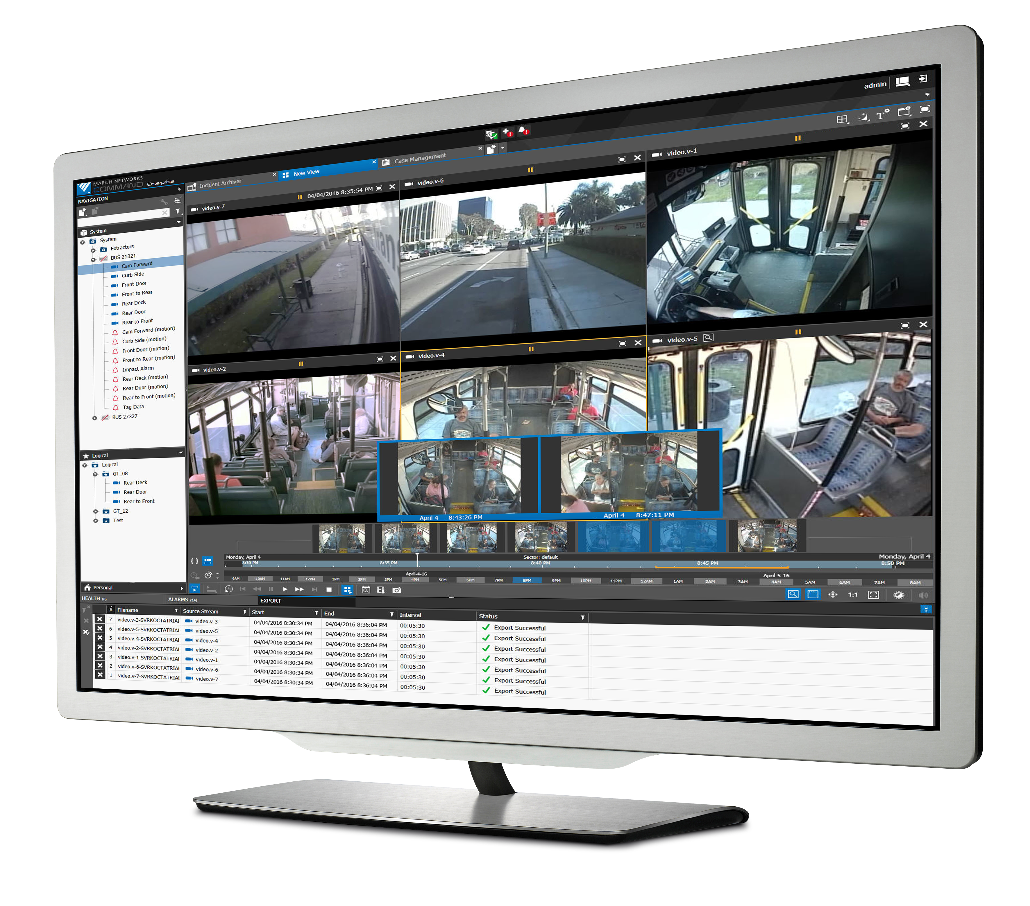
Cloud Management: Command Enterprise for Transit
The enterprise management platform that helps you manage both your mobile and fixed environments like never before
Access a visual overview of what’s happening on all routes, complete with details on recorded events such as speed, hard brakes, door malfunctions, impacts, and panic buttons
Integrated vehicle metadata evidence
Automated, high-speed wireless video and data extraction
Rapid search and robust case management

Slide 10
Cloud Management: Command Enterprise for Transit
RideSafe XT Sleep Mode
Problem Buses shut down at night with no ability to record motion of unusual activity (vandalism or vagrants)
Current solution: Recorders on buses are equipped with standard motion detection which is slow to initialize and record unusual activity
This feature will allow XT units to switch to low-power mode and record directly to the recorder’s SD card, based on configurable rules like motion
It also allows for around-the-clock recording coverage, even when buses are parked and powered down
The March Networks Solution: Thanks to Sleep Mode, recorders can capture the entire motion event and record motion in real-time

Slide 11
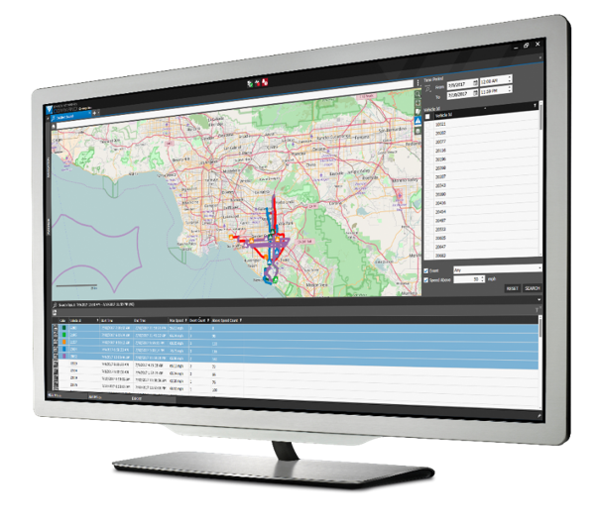
Cloud Management: Command for Transit
Integrated HD video and vehicle metadata
Ability to search by date, time, event, speed, and geography to find the evidence you need for faster investigations
Search for events such as speeding vehicles or use of hard brakes using a date and vehicle location
Redundancy of critical video allows for ease of use and ease of sharing with first responders in the event of a crisis

Slide 12
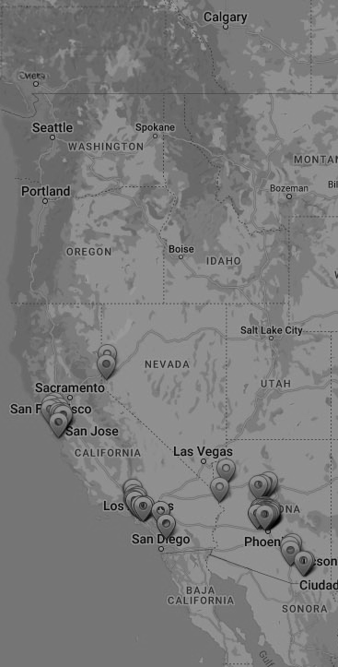
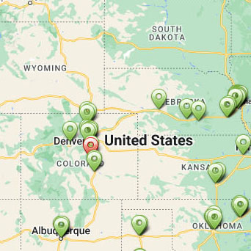
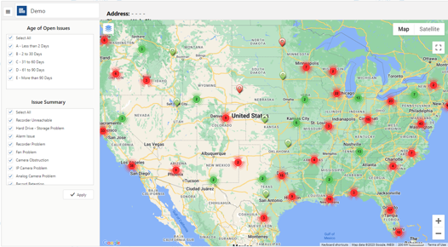
Cloud Monitoring: Insight Cloud Services
We ensure your system is up and running
Proactive monitoring of your cameras, NVRs, encoders, hard drives, fans, battery backups, and overall network connectivity
Remote troubleshooting and issue resolution, software maintenance and updates, scheduled during off-peak hours
Online self-serve access to your video installation information, including maps, support tickets and ticket status, and device warranty and location information for complete closed-loop service workflows

Slide 13
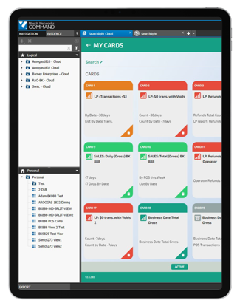
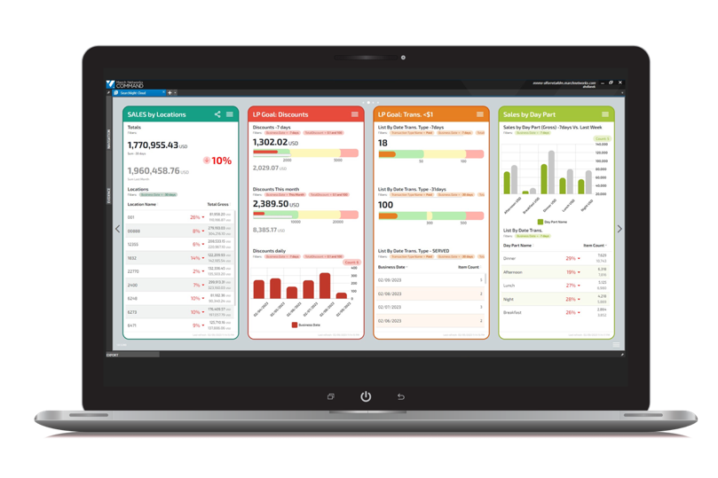
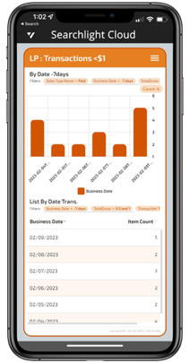
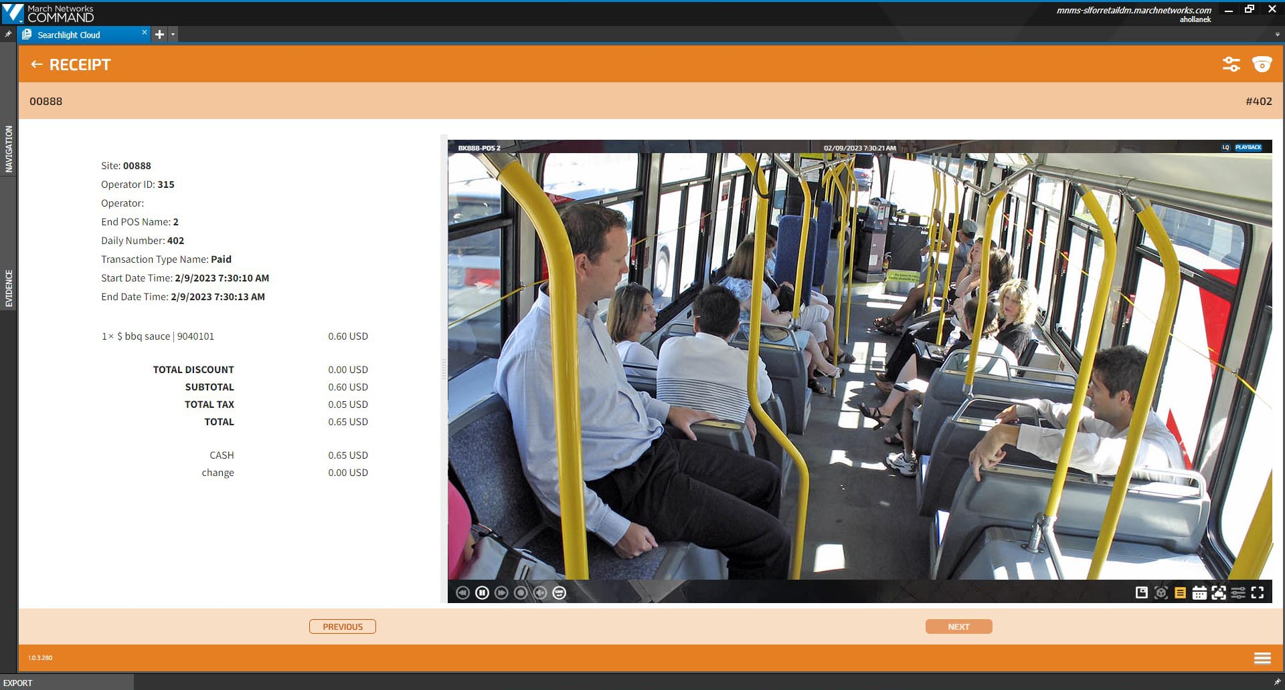
Cloud Analytics: Searchlight Cloud
A platform providing superior video surveillance integrated with vehicle metadata and analytics for superior security and transit agency optimization
Key Advantages
Identify trends and potential issues via intelligent dashboards and report cards.
View your recorded video to save time in investigations.
Receive real-time alerts — person on a bus with no driver present, bus occupancy, hard braking, etc.

Slide 14
Searchlight for Business Intelligence
Optional analytics to improve customer service and transit agency efficiency
People counting analytics
Analyze occupancy over time to plan route changes
Integrate with vehicle metadata to obtain evidence
After hours monitoring analytics
Keep an eye on your fleet after hours and get alerts for suspicious activity, such as a person on a bus with no driver present
Driving analytics
Set up alarm monitoring and actions for incidents that involve hard braking, reckless driving, etc.

Slide 15
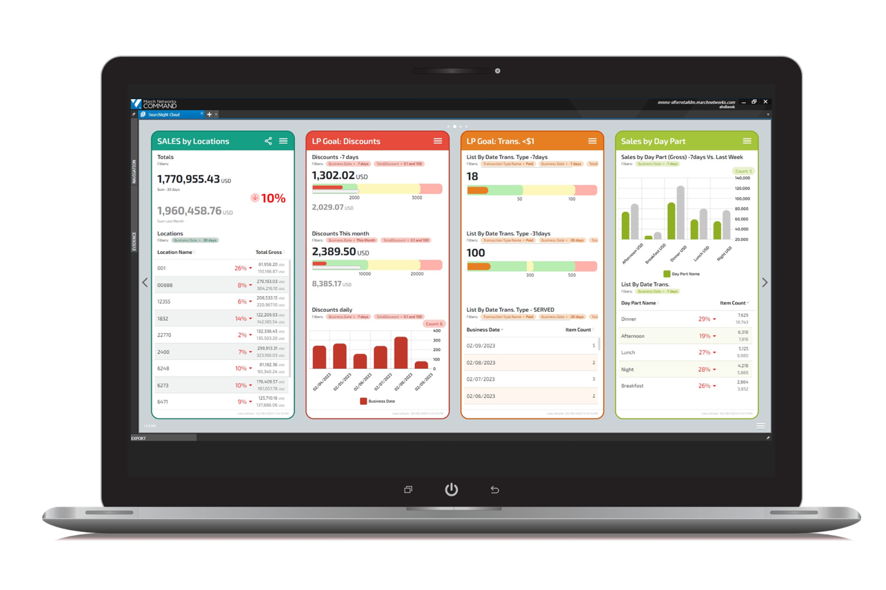
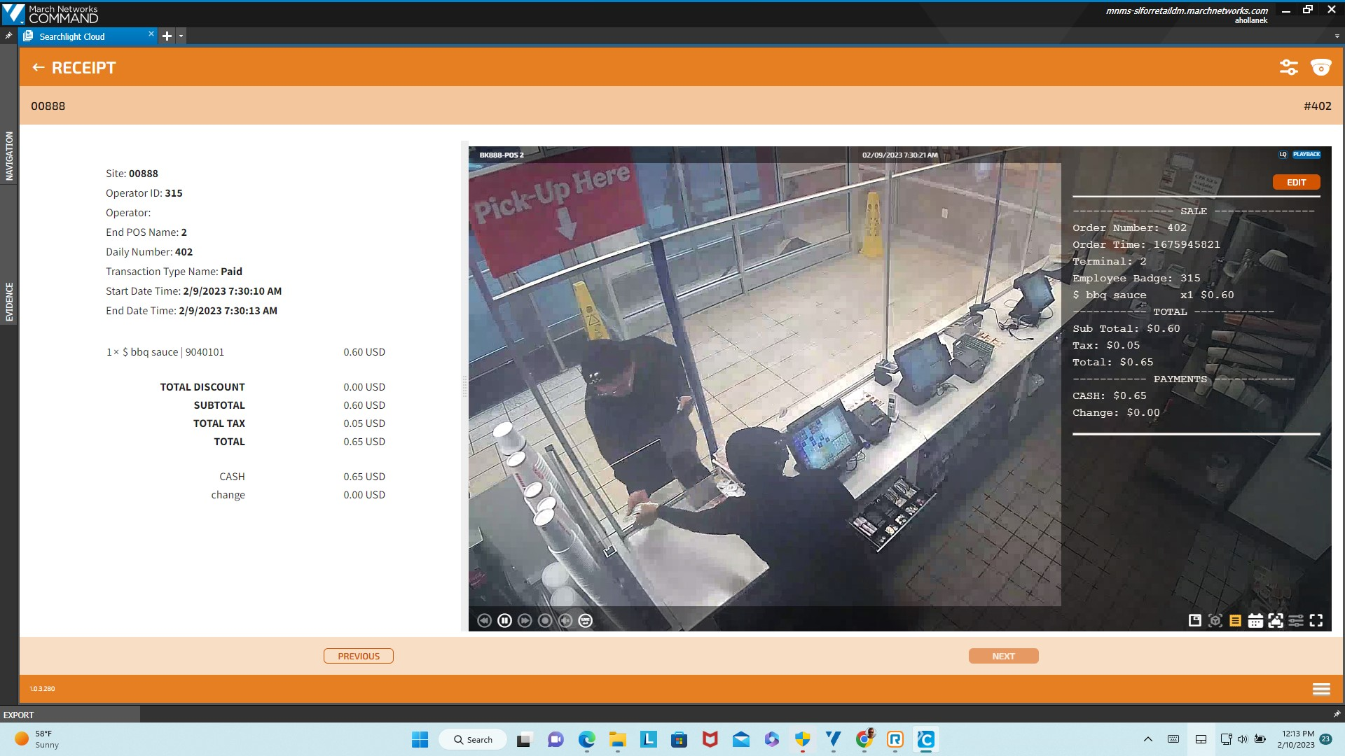
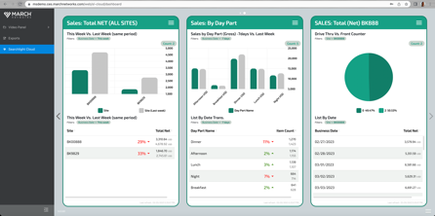
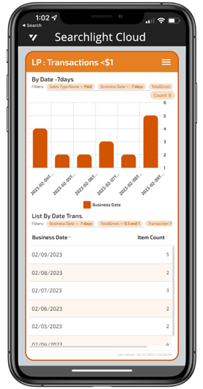
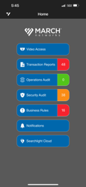
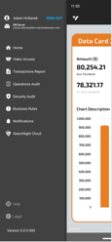
All Cloud Suite Services are available on PC, Web & Mobile
PC
WEB
MOBILE
APP

Slide 16
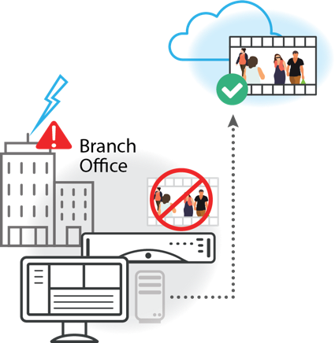
Cloud Storage: The March Networks Advantage
Pain Point:
Only local backup means the potential for the loss of important video
Solution:
Backup to the cloud means you can keep all your videos, or just the important ones, safe with complete redundancy and maximum reliability
Power surge damages onsite data
Safely store data for extended periods of time
Typical data storage of 30 days
Backup all your recorded video or pick and choose which video evidence to keep

Slide 17
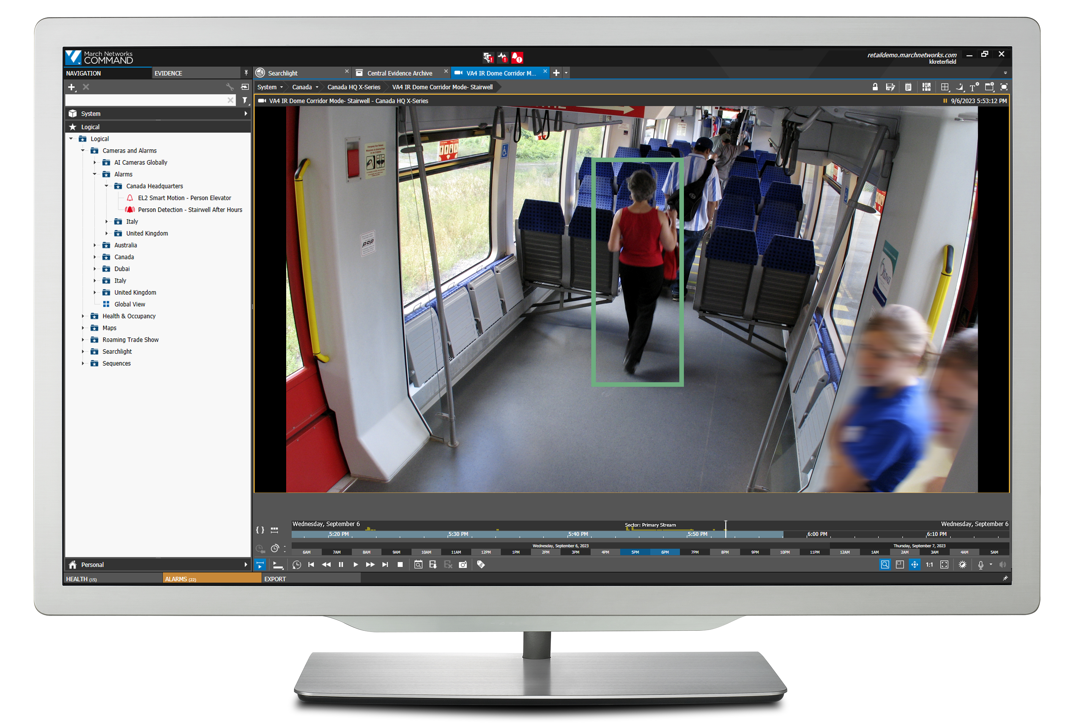
What are the benefits of Cloud Storage?
Don't lose important video with truly redundant cloud storage backup
You can address your varied bandwidth by location, by pushing all your video, or only some, such as triggered alarms to the cloud
Support your IT department’s strategy to move all Enterprise Apps to the cloud. We offer two flexible options for unique storage and bandwidth demands:
Central Evidence Archive
Allows automated video uploads and backups of video to private cloud/customer data center
Cloud Storage Service
Allows automated video uploads and backups of video to Cloud storage
Have automated alarms send relevant video to the cloud immediately
Easy to configure, select cameras and record based on schedules, alarms, or manual selections

Slide 18
What are the benefits of Cloud Storage?
Automated video uploads and backups of all videos or just your most important videos to the cloud from select or all cameras and recorders, saving you time and money and giving you confidence that you have the video you need when you need it
Extend the length of time you can store and share video, giving you peace of mind and helping you meet compliance requirements
See manual, scheduled, and automatically triggered video in a single screen

Slide 19
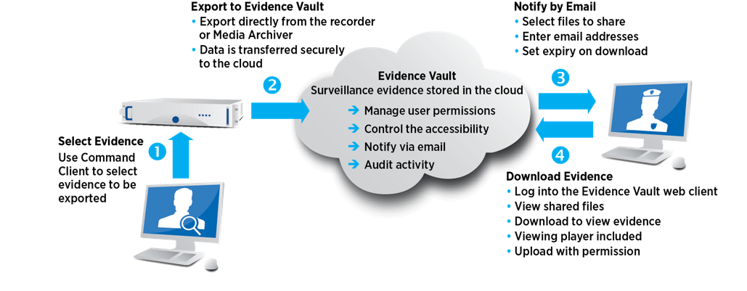
Cloud Sharing: Evidence Vault
Looking for an easy way to safely share cases outside of your network without the hassle of portable media or the vulnerabilities of email and file-sharing options?
Evidence Vault lets you securely export cases to the cloud, and then share them with authorized recipients.
Secure cloud-based evidence sharing
How does it work?

Slide 20
Product Portfolio

Slide 21
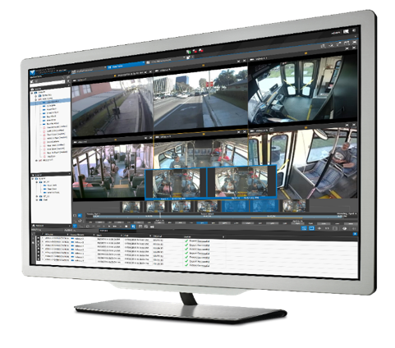
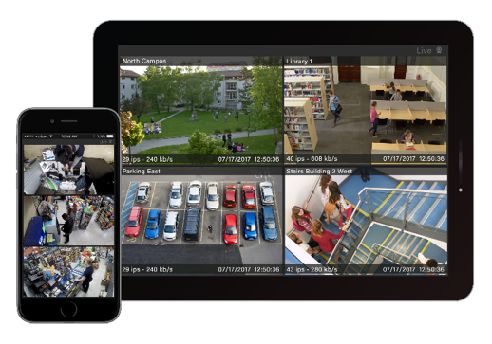
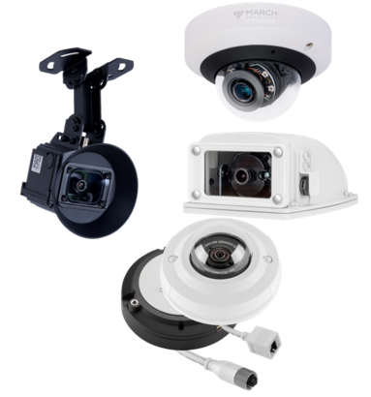
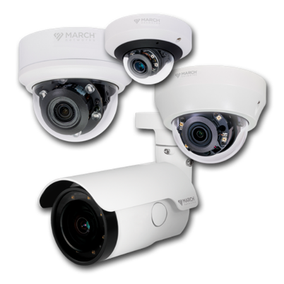
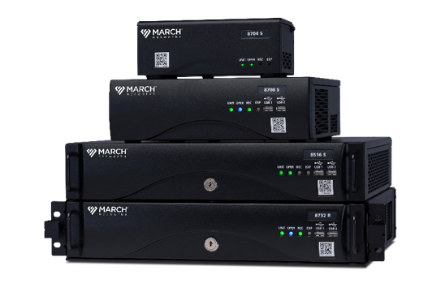
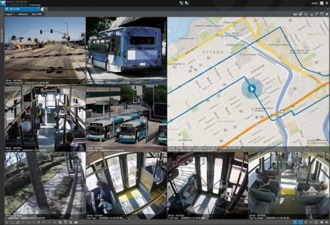
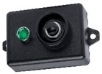
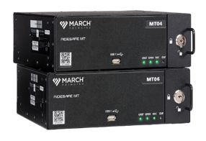
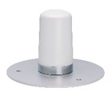
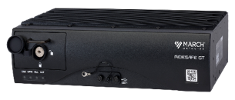
Complete Video Solutions
MOBILE
IP AND HYBRID RECORDERS
MOBILE PERIPHERALS
MOBILE
IP AND HYBRID RECORDERS
MOBILE PERIPHERALS
Cloud Management
FIXED
IP, TRIBRID
AND HYBRID RECORDERS
FIXED
IP, TRIBRID
AND HYBRID RECORDERS
SMARTPHONE APPLICATION
SMARTPHONE APPLICATION
Cloud Monitoring
Cloud Sharing
ENTERPRISE MANAGEMENT
ENTERPRISE MANAGEMENT
Cloud Suite
FIXED
IP CAMERAS AND
ENCODERS
FIXED
IP CAMERAS AND
ENCODERS
VIDEO MANAGEMENT SOFTWARE
VIDEO MANAGEMENT SOFTWARE
Cloud Storage
Cloud Analytics
MOBILE
IP CAMERAS AND ENCODERS
MOBILE
IP CAMERAS AND ENCODERS
CLOUD SUITE
CLOUD SUITE

Slide 22
Recorders

Slide 23
Ruggedized Mobile Platform for Transit
RideSafe XT Series IP NVRs
8,12 and 16-channel models
All-IP video recording – now with Sleep Mode Functionality
NDAA-compliant – no hassle, fully grant-fundable devices
Record at full 30 fps at 1080p resolution across all channels simultaneously
A solution meant for the future. This plug-and-play recorder can integrate into your existing Intelligent Transportation Systems (ITS) and mobile routers, or it can operate independently and be remotely managed and monitored daily.
Powerful Video Management Software. Easily manage your entire fleet as well as your fixed surveillance with March Networks Command for Transit. Features include health monitoring, remote live video access, data logging/search, fleet revision management, GPS mapping, and more.
Powered by NVIDIA® System on a Chip (SoC). SoC technology includes both hardware and firmware, so it uses less power, performs better, requires less space, and is more reliable than multi-chip systems.
Transit-tough. Able to withstand extreme and demanding continual loads, these embedded Linux-based recorders adhere to J1455 specifications and provide IP65 protection from dust and moisture.
Automated video and data extraction. Trigger automatic downloads, via Wi-Fi or 4G/LTE networks, of critical video when the bus returns to the depot.

Slide 24
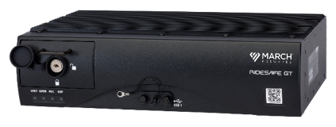
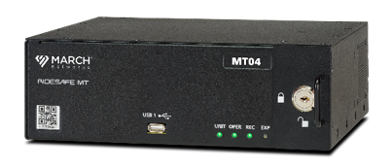
Ruggedized Mobile Platform for Transit
RideSafe GT and MT Series video recorders
Embedded Linux OS, purpose-built to withstand harsh transit environments
Automated video and data extraction over WiFi and 4G/LTE networks
CAD/AVL data integration for advanced search and investigation
Central management and system health monitoring with Command for Transit video management software
RideSafe GT Series Hybrid Transit NVRs 8, 12, 16, and 20-channel models Hybrid analog/IP video recording Record at full 30 fps at D1 resolution across all channels simultaneously | RideSafe MT Series IP Recorders 4 and 6-channel models All-IP video recording Record at full 30 fps at 1080p resolution across all channels simultaneously

Slide 25
High-Performance, Highly Reliable Video Recorders for Fixed Environments
NEW
NEW X-Series All IP Recorder (IPX)
High-capacity, high-definition IP recording platform with RAID
For customers planning an all-IP installation, and requiring a powerful recorder with high throughput, the X-Series All IP Recorder from March Networks® accommodates up to 64 IP cameras and provides a total bandwidth capacity of 600 Mbps.
Key Benefits
Powered by Nvidia System on a Chip (SoC)
IT-grade server-based appliance with Linux-based OS
End-to-end encryption
End-user RAID support
All camera licenses included
Purpose-built for the future with AI capability and Enterprise-class scalability
NDAA compliant – fully grant-fundable

Slide 26
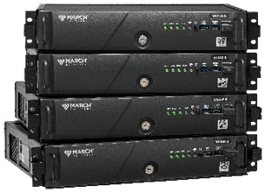
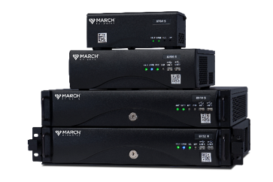
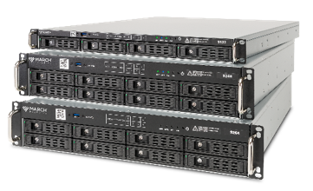
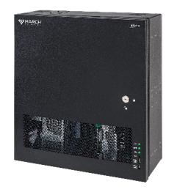
High-Performance, Highly Reliable Video Recorders for Fixed Environments
Flexible recording platforms and models to suit any requirement
Multiple hard-drive options
Centralize video management, health monitoring, and powerful search capabilities with March Networks Command Enterprise
Fully licensed for all video channels, no software licenses or SMA required
X-Series Hybrid Recorders
Analog and IP Video Recording: 8000 Series
IP Video Recording: 9000 Series
HD Analog, IP and Analog: 8724 V

Slide 27
IP Cameras

Slide 28
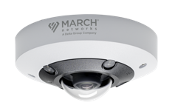
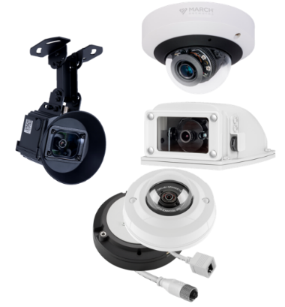
IP Cameras Designed for Specific, Vertical Market Applications
Mobile Cameras
for your Bus Fleet
Fixed Cameras

Slide 29
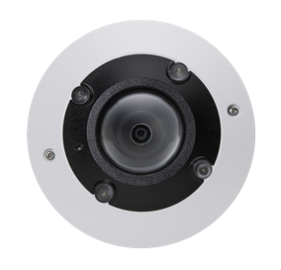
VA5 IR 360°
Camera
NEW
camera with built-in de-warping, video analytics and microphone,
Rugged 5MP IR 360°
built specifically for the transit industry
Built-In Video Analytics
Abandoned Object - an alarm is triggered if an object remains in one spot for too long.
Loitering Detection - an alarm is triggered when people remain in an area for too long.
Tripwire - an alarm is triggered when a person or object crosses the defined line.
Intrusion Detection - an alarm is triggered when people or vehicles enter a specific area.
Object Removal - an alarm is triggered if an object is removed from an area.
No need to purchase and install separate devices for applications that require audio, the VA5 IR 360° Camera has a built-in microphone.
Easily cover four different scenes in a single stream with de-warped viewing modes. Use the quad view or cover an entire area with a fisheye 360° view.
With Smart IR Illumination, the built-in LEDs provide uniform illumination in total darkness, which means users will see high-quality, low-noise video from over 30 feet away.

