Slide 1
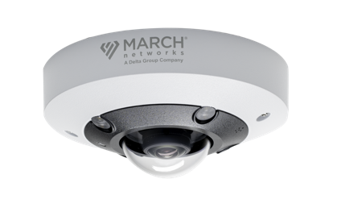
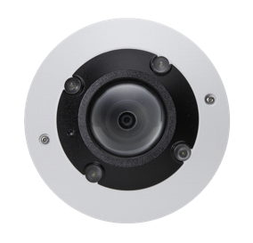
VA5 IR 360°
Camera
camera with built-in de-warping, video analytics and microphone,
Rugged 5MP IR 360°
Built-In Video Analytics
Abandoned Object - an alarm is triggered if an object remains in one spot for too long.
Loitering Detection - an alarm is triggered when people remain in an area for too long.
Tripwire - an alarm is triggered when a person or object crosses the defined line.
Intrusion Detection - an alarm is triggered when people or vehicles enter a specific area.
Object Removal - an alarm is triggered if an object is removed from an area.
No need to purchase and install separate devices for applications that require audio, the VA5 IR 360° Camera has a built-in microphone.
Easily cover four different scenes in a single stream with de-warped viewing modes. Use the quad view or cover an entire area with a fisheye 360° view.
With Smart IR Illumination, the built-in LEDs provide uniform illumination in total darkness, which means users will see high-quality, low-noise video from over 30 feet away.

